Slide 1

Digital Signal Processing
Course Instructor
Dr. Ali J. Abboud
Lecture No. 4: Linear Time Invariant Systems
Third Class
Department of Computer and Software Engineering
http://www.engineering.uodiyala.edu.iq/
https://www.facebook.com/Engineer.College1

Slide 2
Lecture Outline
Analysis of DT-LTI System
Difference Equations
Recursive Systems
Non-recursive Systems
Describing Digital Signals with Impluse Function
Describing Digital LTI Responses
Impulse Response
Step Response
Discrete-Time Convolution
Discrete-Time Circular Convolution
Discrete-Time Correlation
Deconvolution
Dr. Ali J. Abboud

Slide 3
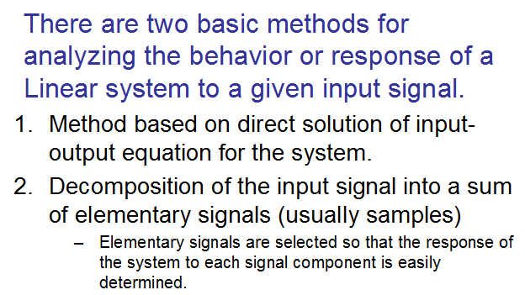
Analysis of DT-LTI system
Dr. Ali J. Abboud

Slide 4
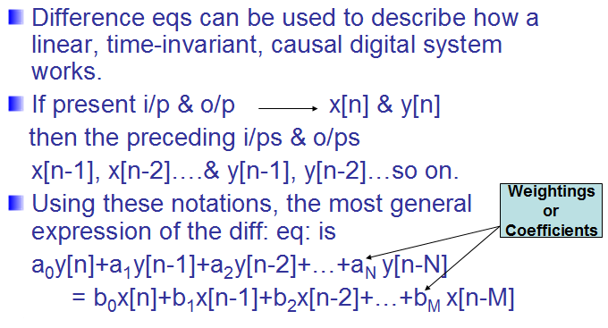
Difference Equations
Dr. Ali J. Abboud

Slide 5
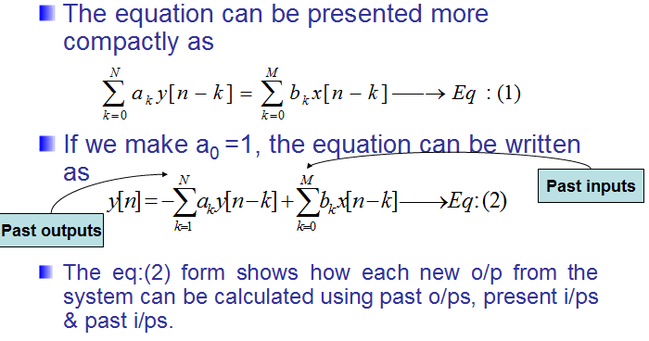
Difference Equations
Dr. Ali J. Abboud

Slide 6
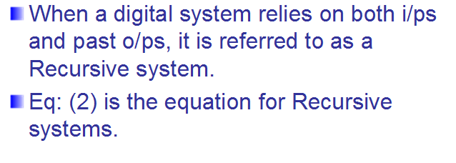
Recursive Systems
Dr. Ali J. Abboud

Slide 7
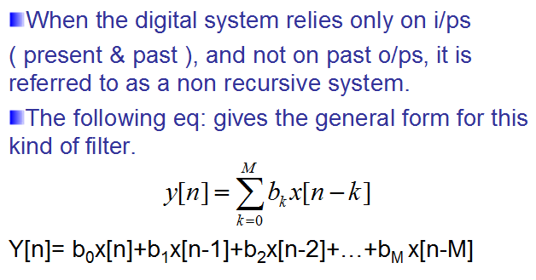
Non-Recursive Systems
Dr. Ali J. Abboud

Slide 8
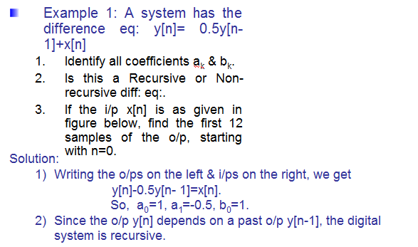
Example: Recursive Systems
Dr. Ali J. Abboud

Slide 9
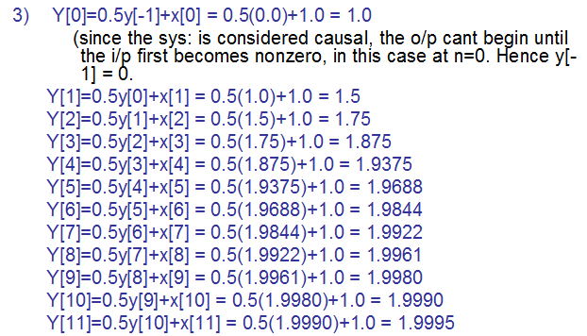
Example: Recursive Systems
Dr. Ali J. Abboud

Slide 10
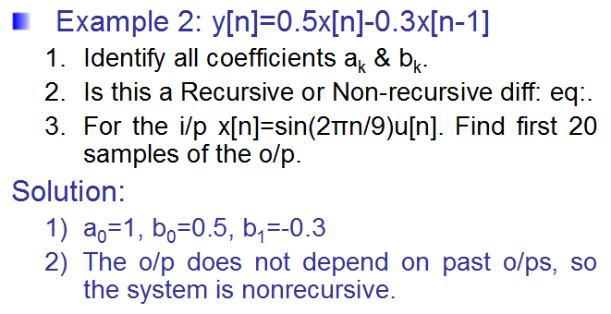
Example: Non-Recursive Systems
Dr. Ali J. Abboud

Slide 11
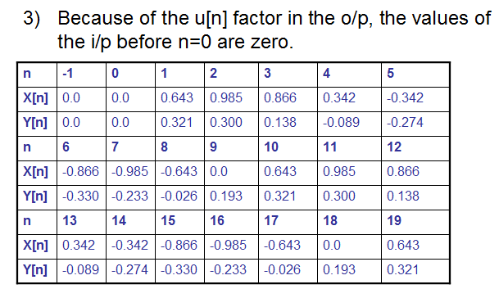
Example: Non-Recursive Systems
Dr. Ali J. Abboud

Slide 12
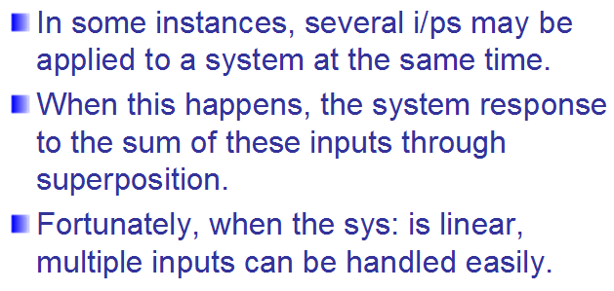
Superposition in Diff: eq:
Dr. Ali J. Abboud

Slide 13
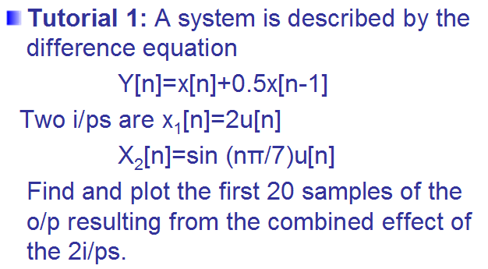
Tutorial 1
Dr. Ali J. Abboud

Slide 14
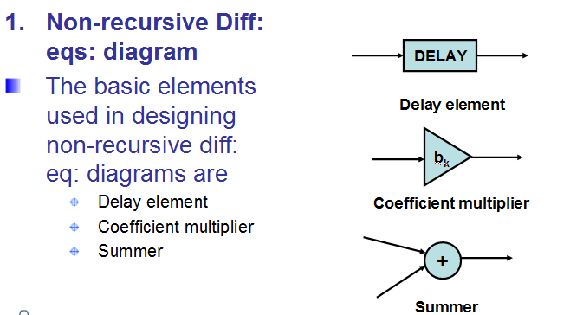
Difference eq: Diagrams
Dr. Ali J. Abboud

Slide 15
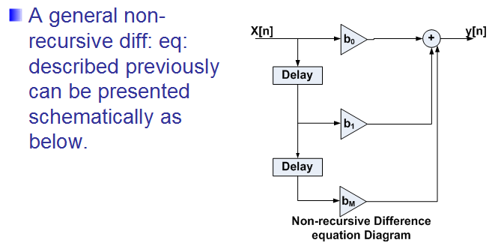
Difference eq: Diagrams
Dr. Ali J. Abboud

Slide 16
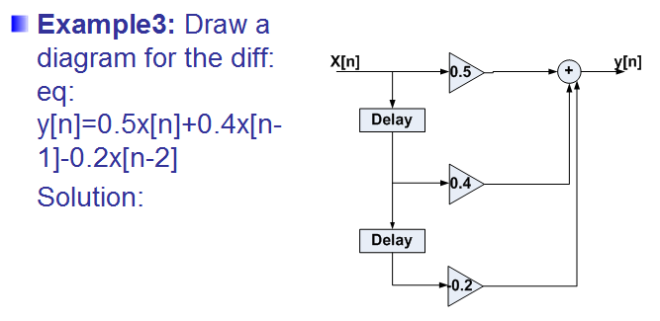
Difference eq: Diagrams
Dr. Ali J. Abboud

Slide 17
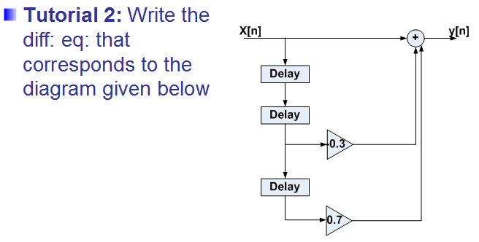
Tutorial 2
Dr. Ali J. Abboud

Slide 18
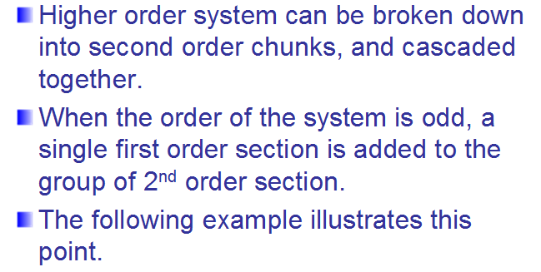
Difference eq: Diagrams
Dr. Ali J. Abboud

Slide 19
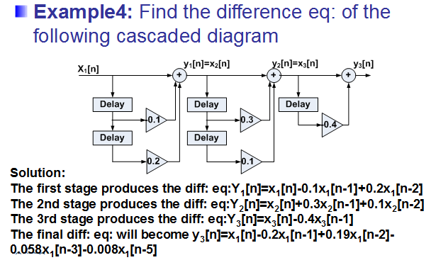
Difference eq: Diagrams
Dr. Ali J. Abboud

Slide 20
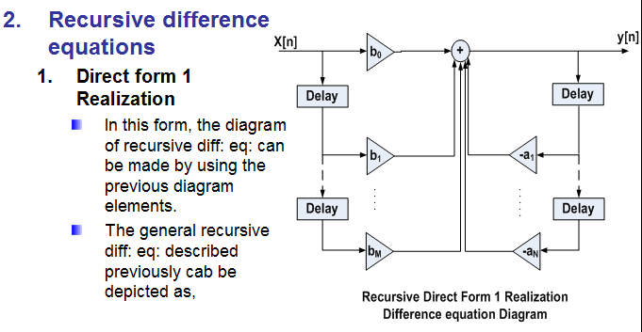
Difference eq: Diagrams
Dr. Ali J. Abboud

Slide 21
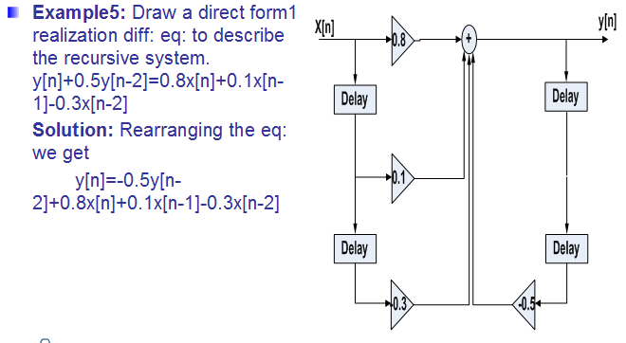
Difference eq: Diagrams
Dr. Ali J. Abboud

Slide 22
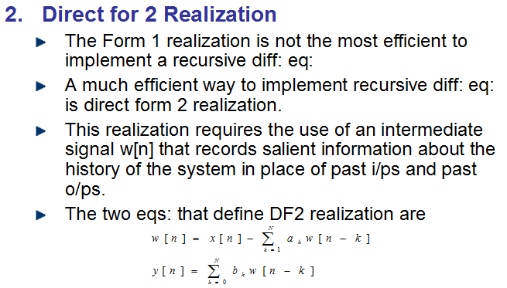
Difference eq: Diagrams
Dr. Ali J. Abboud

Slide 23
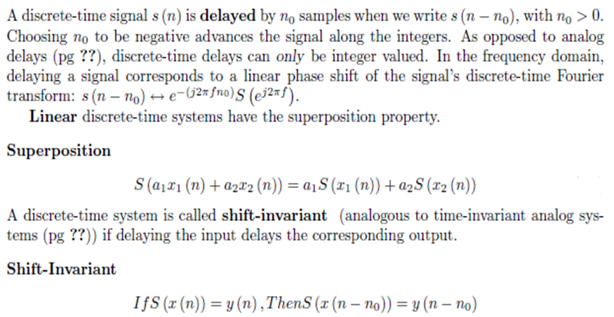
Difference Equation
Dr. Ali J. Abboud

Slide 24
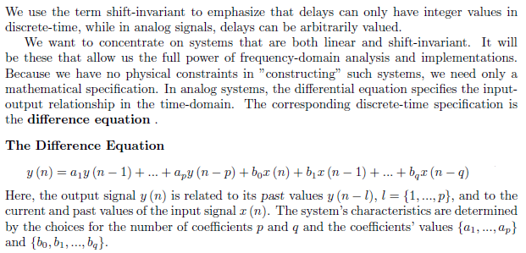
Difference Equation
Dr. Ali J. Abboud

Slide 25
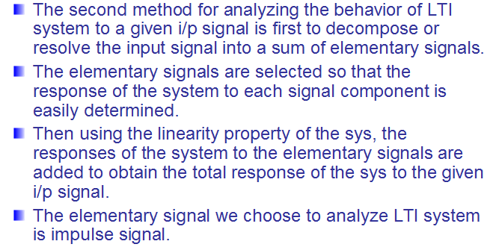
Analysis of DT-LTI system
Dr. Ali J. Abboud

Slide 26
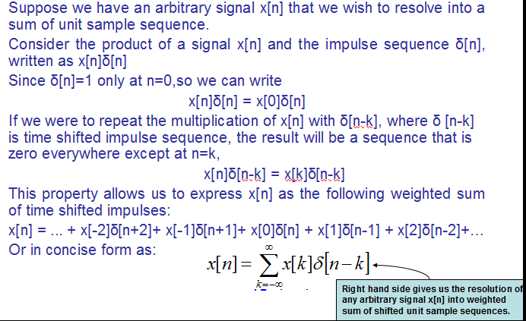
Resolution of DT signals into Impulses
Dr. Ali J. Abboud

Slide 27
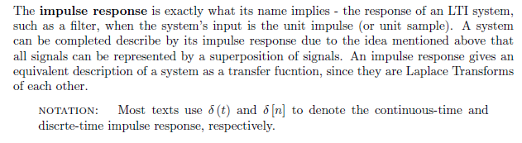
Impulse Response of LTI System
Dr. Ali J. Abboud

Slide 28
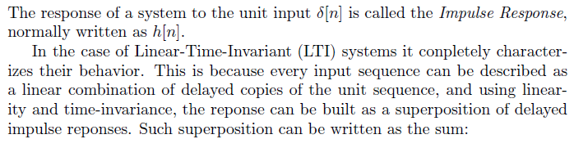
Impulse Response of LTI System
Dr. Ali J. Abboud

Slide 29
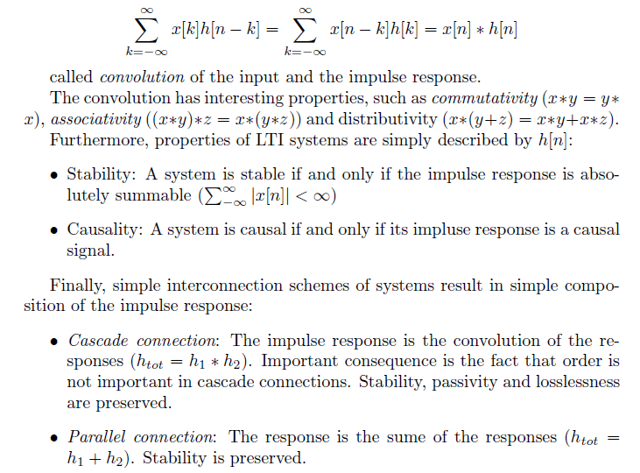
Impulse Response of LTI System
Dr. Ali J. Abboud

Slide 30
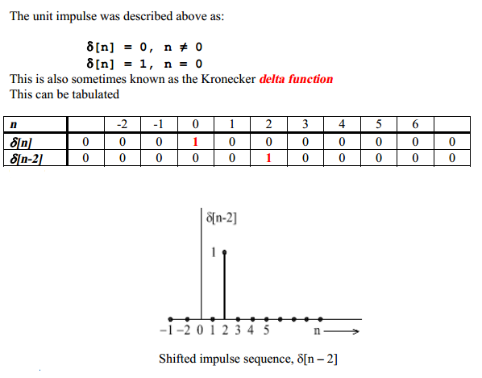
Impulse Response of LTI System
Dr. Ali J. Abboud

Slide 31
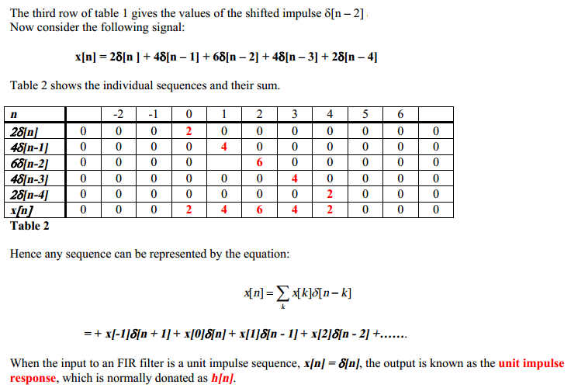
Impulse Response of LTI System
Dr. Ali J. Abboud

Slide 32
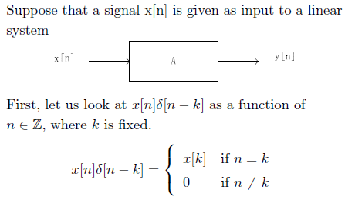
Impulse Response of LTI System
Dr. Ali J. Abboud

Slide 33
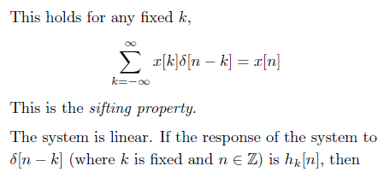
Impulse Response of LTI System
Dr. Ali J. Abboud

Slide 34
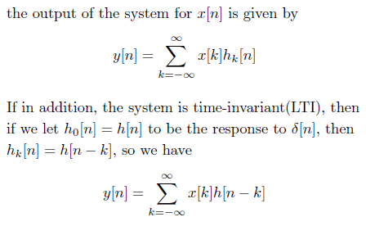
Impulse Response of LTI System
Dr. Ali J. Abboud

Slide 35
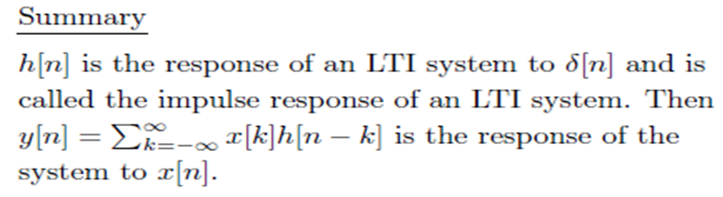
Impulse Response of LTI System
Dr. Ali J. Abboud

Slide 36
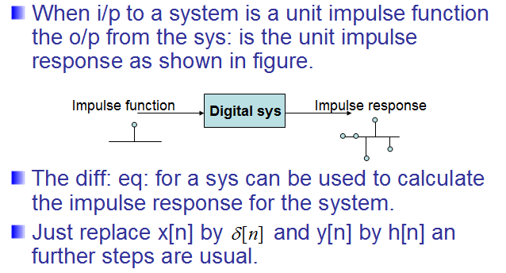
Impulse Response & Difference Eq:
Dr. Ali J. Abboud

Slide 37
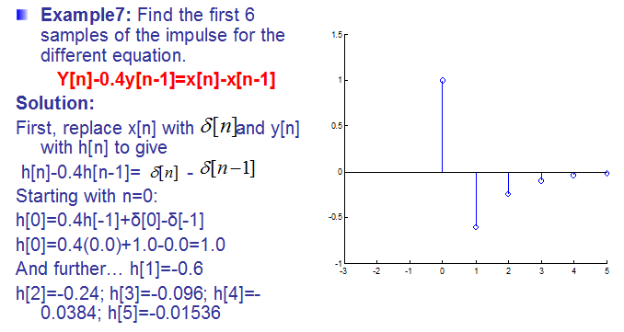
Impulse Response & Difference Eq:
Dr. Ali J. Abboud

Slide 38
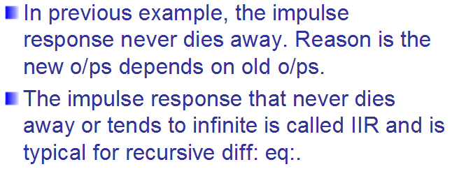
Infinite Impulse Response (IIR)
Dr. Ali J. Abboud

Slide 39
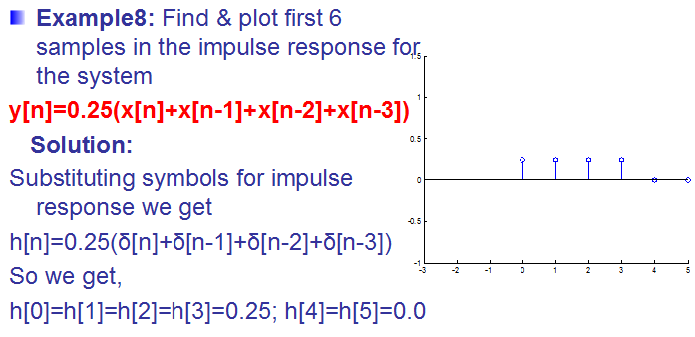
Infinite Impulse Response (IIR)
Dr. Ali J. Abboud

Slide 40
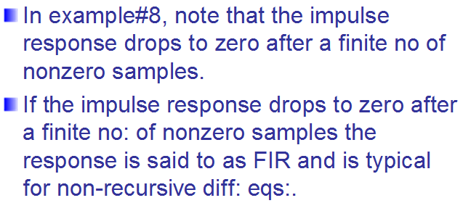
Finite Impulse Response (FIR)
Dr. Ali J. Abboud

Slide 41
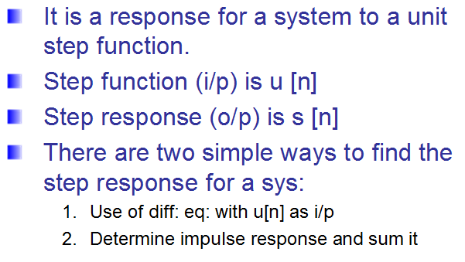
Step Response & Difference Equations
Dr. Ali J. Abboud

Slide 42
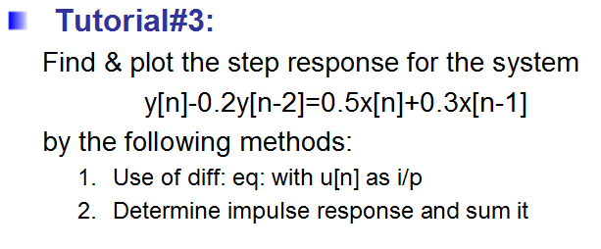
Tutorial 3
Dr. Ali J. Abboud

Slide 43
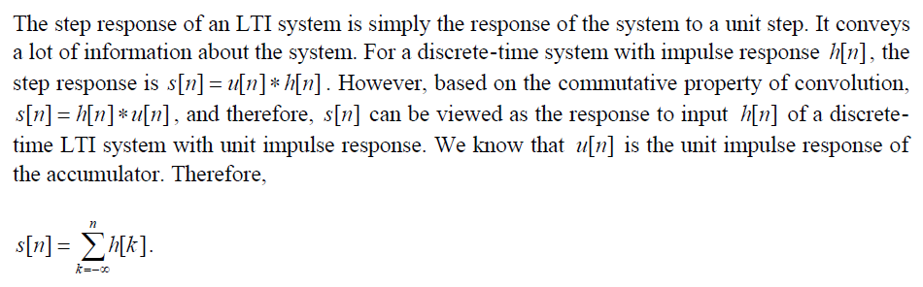
Step Response of an LTI System
Dr. Ali J. Abboud

Slide 44
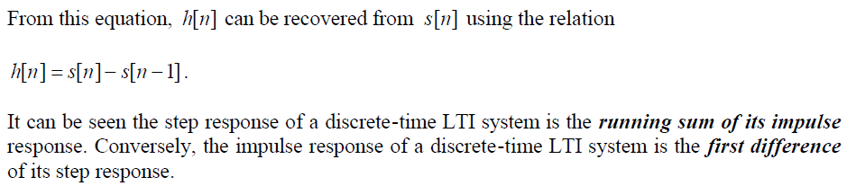
Step Response of an LTI System
Dr. Ali J. Abboud

Slide 45
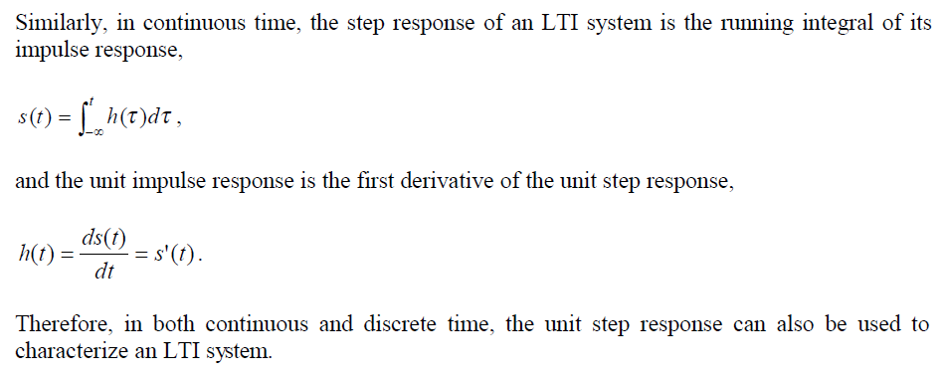
Step Response of an LTI System
Dr. Ali J. Abboud

Slide 46
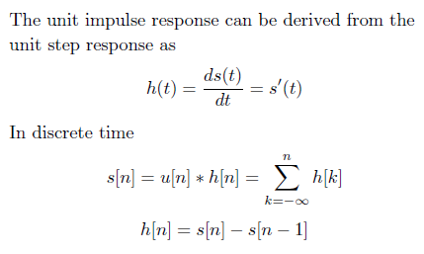
Step Response of an LTI System
Dr. Ali J. Abboud

Slide 47
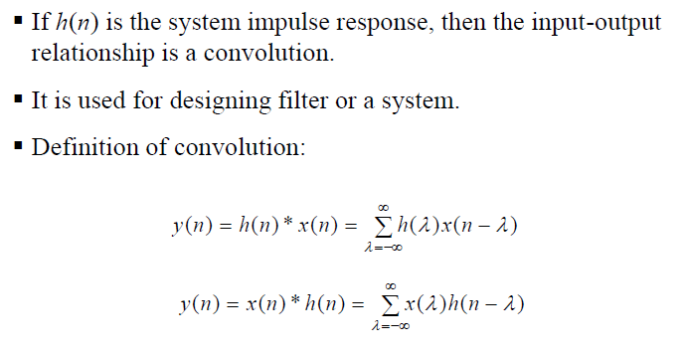
Discrete-Time Convolution
Dr. Ali J. Abboud

Slide 48

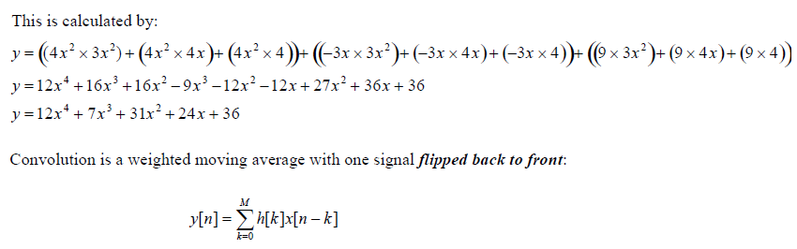
Discrete-Time Convolution
Dr. Ali J. Abboud

Slide 49
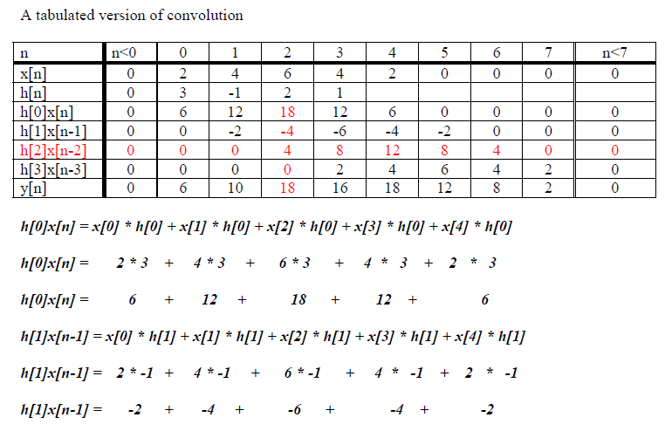
Discrete-Time Convolution
Dr. Ali J. Abboud

Slide 50
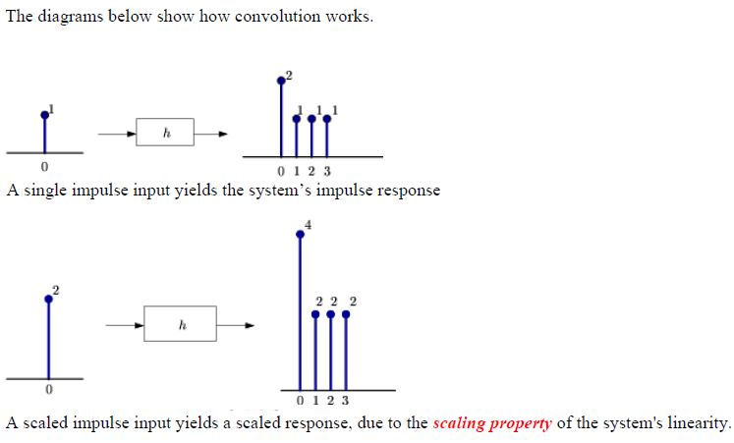
Discrete-Time Convolution
Dr. Ali J. Abboud

Slide 51
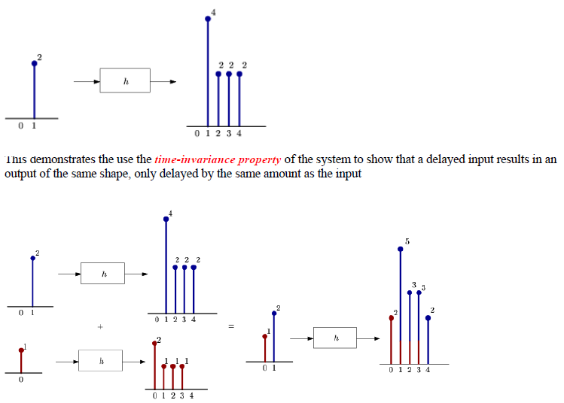
Discrete-Time Convolution
Dr. Ali J. Abboud

Slide 52
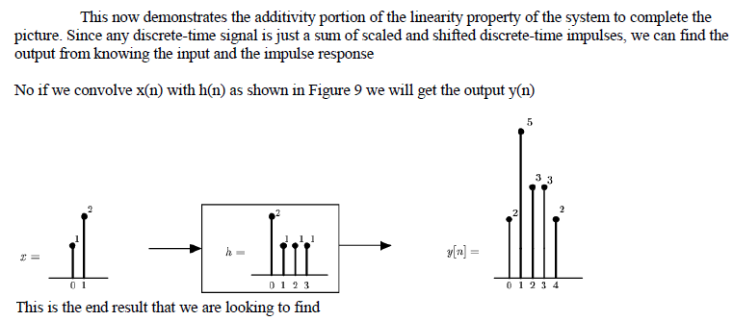
Discrete-Time Convolution
Dr. Ali J. Abboud

Slide 53

Discrete-Time Convolution
Dr. Ali J. Abboud

Slide 54

Discrete-Time Convolution
Dr. Ali J. Abboud

Slide 55

Discrete Time Convolution
Dr. Ali J. Abboud

Slide 56

Discrete Time Convolution
Dr. Ali J. Abboud

Slide 57

Discrete-Time Convolution
Dr. Ali J. Abboud

Slide 58

Discrete-Time Convolution
Dr. Ali J. Abboud

Slide 59

Discrete-Time Convolution
Dr. Ali J. Abboud

Slide 60

Discrete-Time Convolution
Dr. Ali J. Abboud

Slide 61

Discrete-Time Convolution: Example 1
Dr. Ali J. Abboud

Slide 62

Discrete-Time Convolution: Example 1
Dr. Ali J. Abboud

Slide 63

Discrete-Time Convolution: Example 1
Dr. Ali J. Abboud

Slide 64

Discrete-Time Convolution: Example 2
Dr. Ali J. Abboud

Slide 65

Discrete-Time Convolution: Example 2
Dr. Ali J. Abboud

Slide 66

Discrete-Time Convolution: Example 2
Dr. Ali J. Abboud

Slide 67

Discrete-Time Convolution: Example 2
Dr. Ali J. Abboud

Slide 68

Performance of Convolution
Dr. Ali J. Abboud

Slide 69
Deconvolution
Unwanted convolution is an inherent problem in transferring analog information. For instance, all of the following can be modelled as a convolution: image blurring in a shaky camera, echoes in long distance telephone calls, the finite bandwidth of analog sensors and electronics, etc. Deconvolution is the process of filtering a signal to compensate for an undesired convolution.
The goal of deconvolution is to recreate the signal as it existed before the convolution took place. This usually requires the characteristics of the convolution (i.e., the impulse or frequency response) to be known. This can be distinguished from blind deconvolution, where the characteristics of the parasitic convolution are not known. Blind deconvolution is a much more difficult problem that has no general solution, and the approach must be tailored to the particular application.
Dr. Ali J. Abboud

Slide 70
Deconvolution
Deconvolution is nearly impossible to understand in the time domain, but quite straightforward in the frequency domain. Each sinusoid that composes the original signal can be changed in amplitude and/or phase as it passes through the undesired convolution. To extract the original signal, the deconvolution filter must undo these amplitude and phase changes.
For example, if the convolution changes a sinusoid's amplitude by 0.5 with a 30 degree phase shift, the deconvolution filter must amplify the sinusoid by 2.0 with a -30 degree phase change.
Dr. Ali J. Abboud

Slide 71

Deconvolution
Dr. Ali J. Abboud

Slide 72


Deconvolution
Dr. Ali J. Abboud

Slide 73

Deconvolution
Dr. Ali J. Abboud

Slide 74

Correlation
Dr. Ali J. Abboud

Slide 75

Correlation
Dr. Ali J. Abboud

Slide 76

Cross-Correlation
Dr. Ali J. Abboud

Slide 77

Cross-Correlation
Dr. Ali J. Abboud

Slide 78

Cross-Correlation
Dr. Ali J. Abboud

Slide 79

Cross-Correlation
Dr. Ali J. Abboud

Slide 80

Auto-Correlation
Dr. Ali J. Abboud

Slide 81

Properties of Auto-correlation and Cross-correlation
Sequences
Dr. Ali J. Abboud

Slide 82

Properties of Auto-correlation and Cross-correlation
Sequences
Dr. Ali J. Abboud

Slide 83

Properties of Auto-correlation and Cross-correlation
Sequences
Dr. Ali J. Abboud

Slide 84

Properties of Auto-correlation and Cross-correlation
Sequences
Dr. Ali J. Abboud

Slide 85

Difference between Convolution and Correlation
Dr. Ali J. Abboud

